Slide 1

Student database management system
SUBMITTED By;
Vinay Kumar-ENG18EC0001
Abhiram MV-ENG18EC0002
Akshay Ram K-ENG18EC0006
Gurgo Testan-ENG17EC0033
Khundrakpam Neelachandra Singh-ENG17EC0047
Submitted to:
Sneha Sharma
Assistant Professor
Dept. of ECE
SoE, DSU

Slide 2
INTRODUCTION
Databases are being used in every aspect of our lives right now.
Trillions of bytes of data are being stored in servers around the world. SQL is one of the most basic methods to use such a database.
C++ can also be used to maintain such a database

Slide 3
APPLICATIONS
Universities
Banking
Airlines
Finance
Telecommunication
Sales
Manufacturing
E-commerce

Slide 4
Problem:
In many institutions it is very difficult to maintain the students data ,due to this reason it is very difficult to check information about any student .
Solution:
Due to many reasons we may want create a system which can handle students information so that these difficulties can be decreased. So a student information management system was designed

Slide 5
Approach
We created individual functions for every operation. All the functions are unified together to form the information system
We can perform the following tasks on the student information system :
To add the student data in database.
To search the student data from the database.
To modify the student data in database.
To display the data

Slide 6
tasks
Student information system performs the following tasks:
Record Entry Section :
In these section the data has been entered and saved.
Searching record section :
In these section we can search any student data through
their name or roll number
Display Section:
In these section we can display all student data once glance

Slide 7
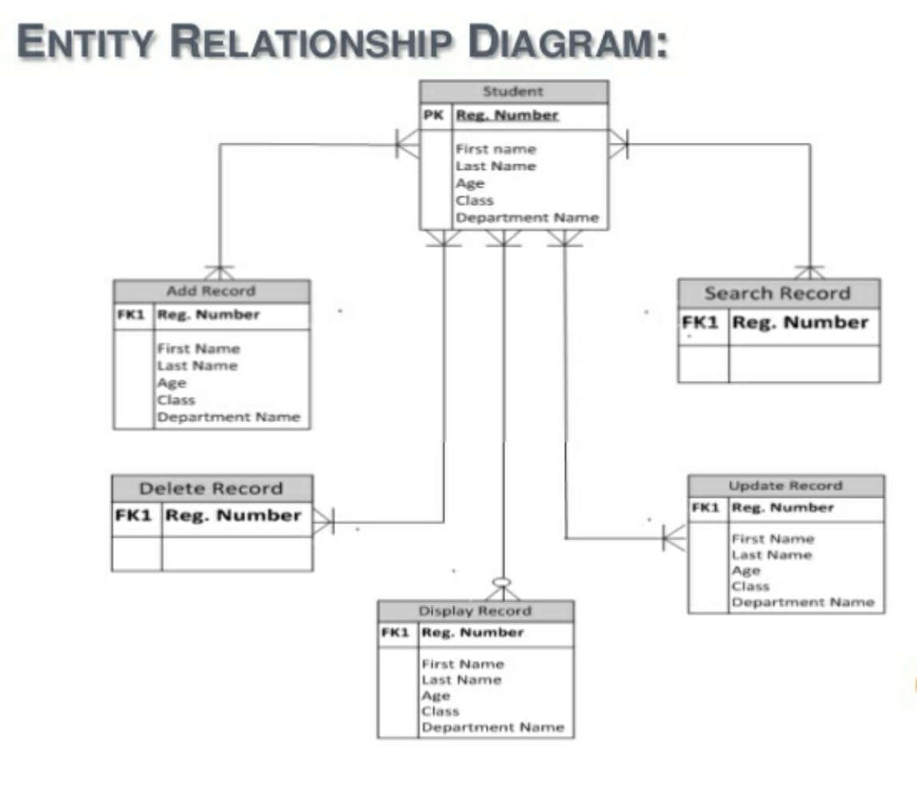

Slide 8
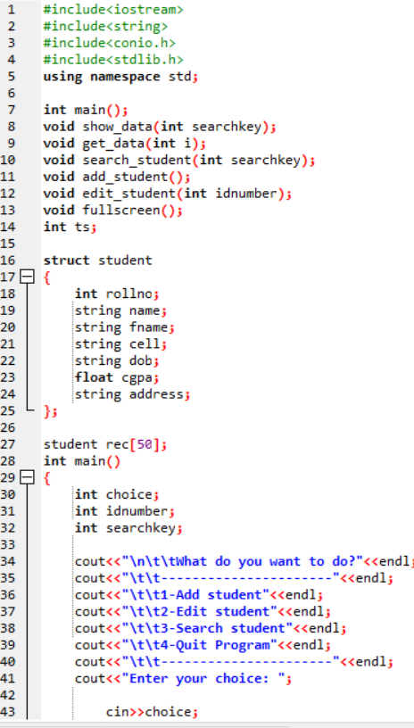
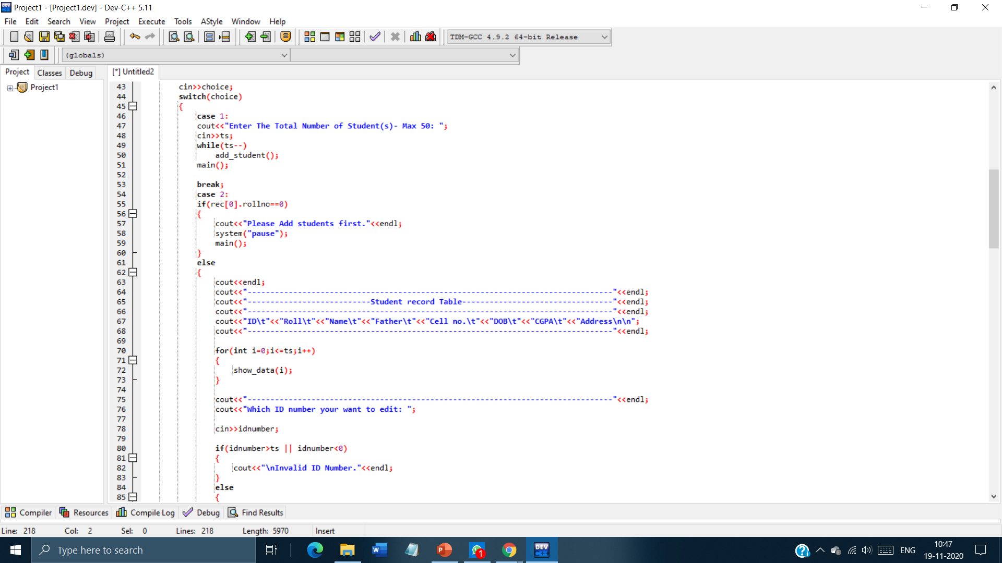
PROGRAM

Slide 9
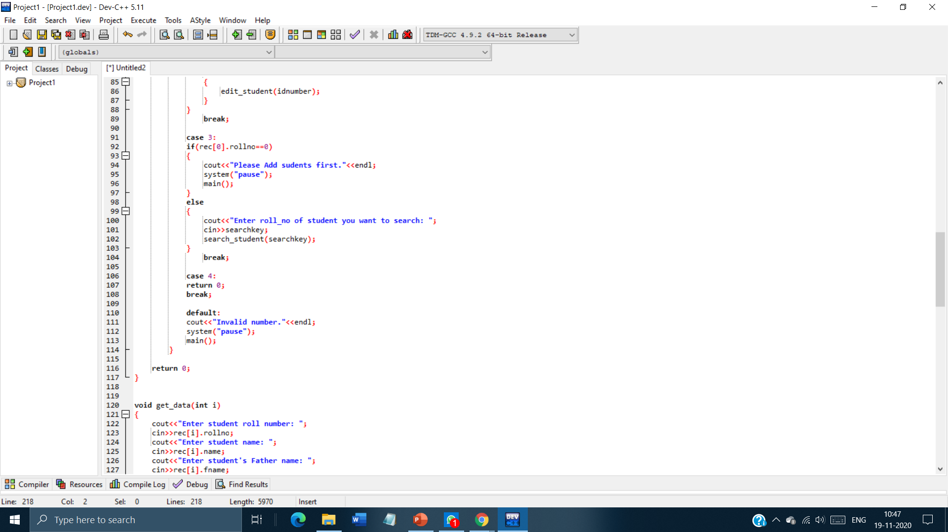
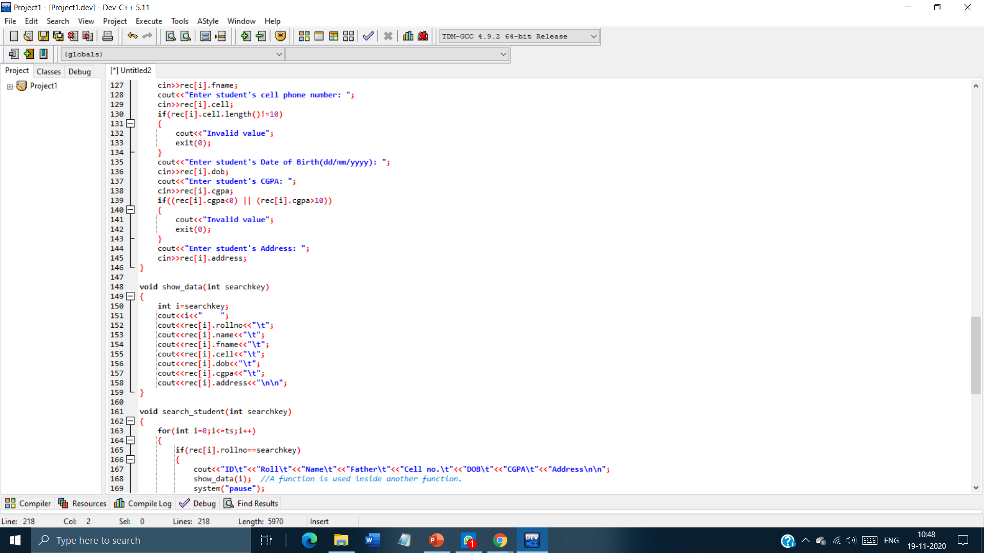

Slide 10
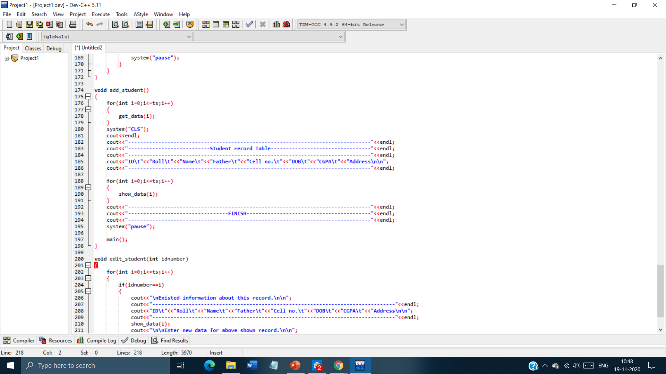
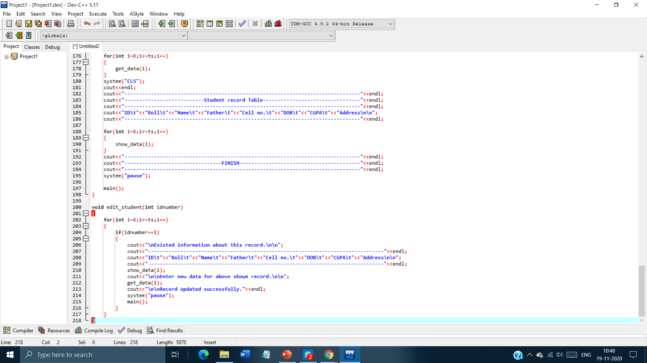

Slide 11
THANK YOU

